Slide 1
School community council june 9th, 2026
7:00-8:00
Dunbarton Library

Slide 2
Year in review 2025/2026
To build a respectful, inclusive and dynamic School Community Council (SCC), that supports an environment in which students, staff and the school community can thrive.
Rooted in a strong foundation, the SCC brings diverse voices together and empowers them to influence change through meaningful collaboration and shared decision-making, where every voice is heard and valued.

Slide 3
Feedback to consider for the 2025/2026 year

Slide 4
Feedback
Identify goals and objectives at the start of the year and work toward them
Engage as many Dunbarton parents & caregivers as possible
Propose a polit project to the DDSB, for Child and Youth Worker presence for the hallways to support students in need
Create opportunities for parents & caregivers to participate in small meaningful ways in addition to meetings and working groups
Continue to support the PROGrant and SCC Bursary
Increase consultation opportunities between the administration and the council

Slide 5
2025/2026 achievements

Slide 6
Goals and objectives
Had a council brainstorming session dedicated to determining goals and objectives for the year based on feedback from previous years
Identified subcommittees required to achieve our goals and objectives
  1. Fundraising/Bursary/PROGrant
  2. Staff and student wellness
  3. Caregiver and community engagement
  Recruited council members for participation on each subcommittee enabling parents and caregivers to participate in ways that were meaningful to them

Slide 7
Fundraising/Bursary/PROGrant Committee

Slide 8
Fundraising/Bursary/PROGrant
Incredible efforts with fundraising to work toward raising
Several different fundraising opportunities successfully completed:
  Two School Cash Online donations for: Leaf Ticket Raffle & Lacrosse Ticket Raffle/OTF passes
  Swiss Chalet Dunbarton Night
  COBS Bread Dunbarton Day
  $3,000+ Raised

Slide 9
PROGrant
Proposal submitted for $4,500 grant toward hosting a parent and caregiver wellness night
Committee came back with more questions…..a LOT more
Didn’t get approval
Feedback sent to the committee on barriers and recommendations centrally, that secondary schools have a portion of the funds dedicated to support initiatives – very few secondary schools approved

Slide 10
Student bursary
Student bursary for $500
Criteria: Good academic standing, demonstrated leadership in the school and outside of the school community and evidence of ongoing commitment to leadership
Executive reviewed the applications (350-500 word application on how they demonstrate the criteria)
Recipient selected and will be awarded the bursary at graduation

Slide 11
Staff and Student Wellness

Slide 12
Student wellness
Successful teacher supported “enhanced hallway presence” pilot in 2024/2025 – results: reduced student presence in the hallway, vandalism and bathroom misuse
Formal proposal for funding of a 1 year CYW sent to the DDSB for consideration through the ad hoc violence in schools committee – Child and Youth Worker for hallway presence to support students in need, based on proven success of last year’s pilot
Proposal was approved and sent through to the DDSB budget meeting
No additional information since

Slide 13
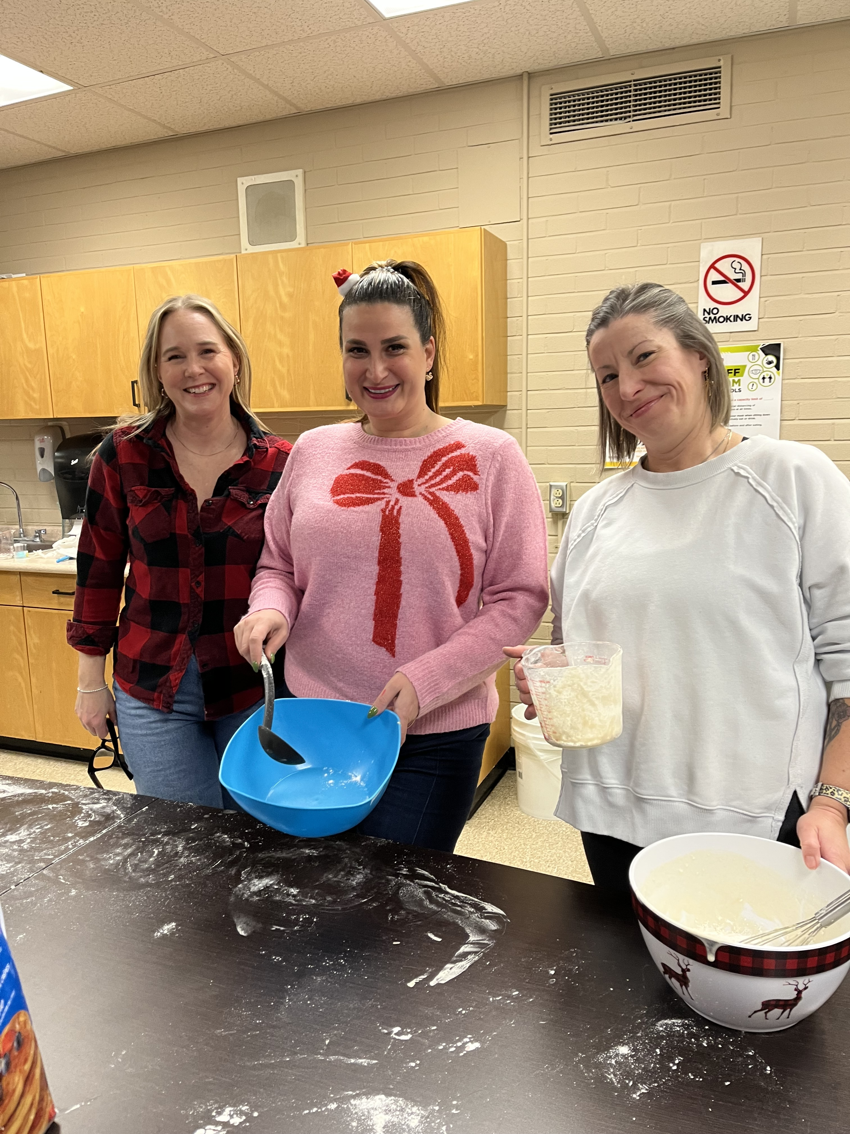
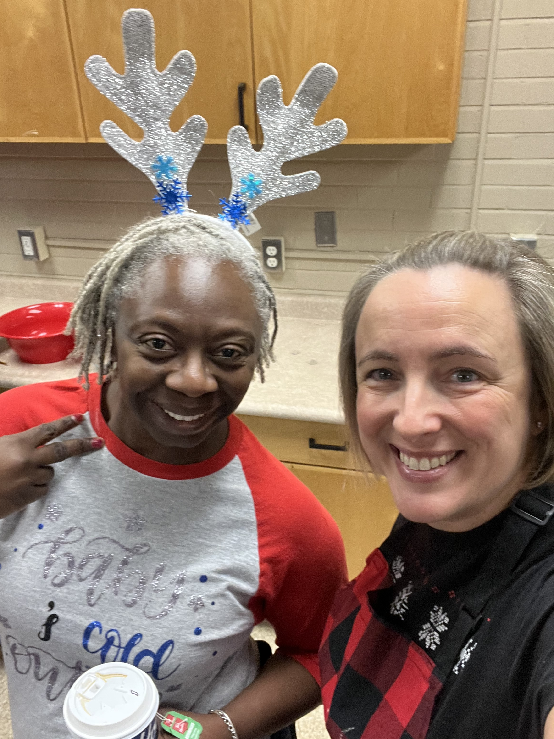
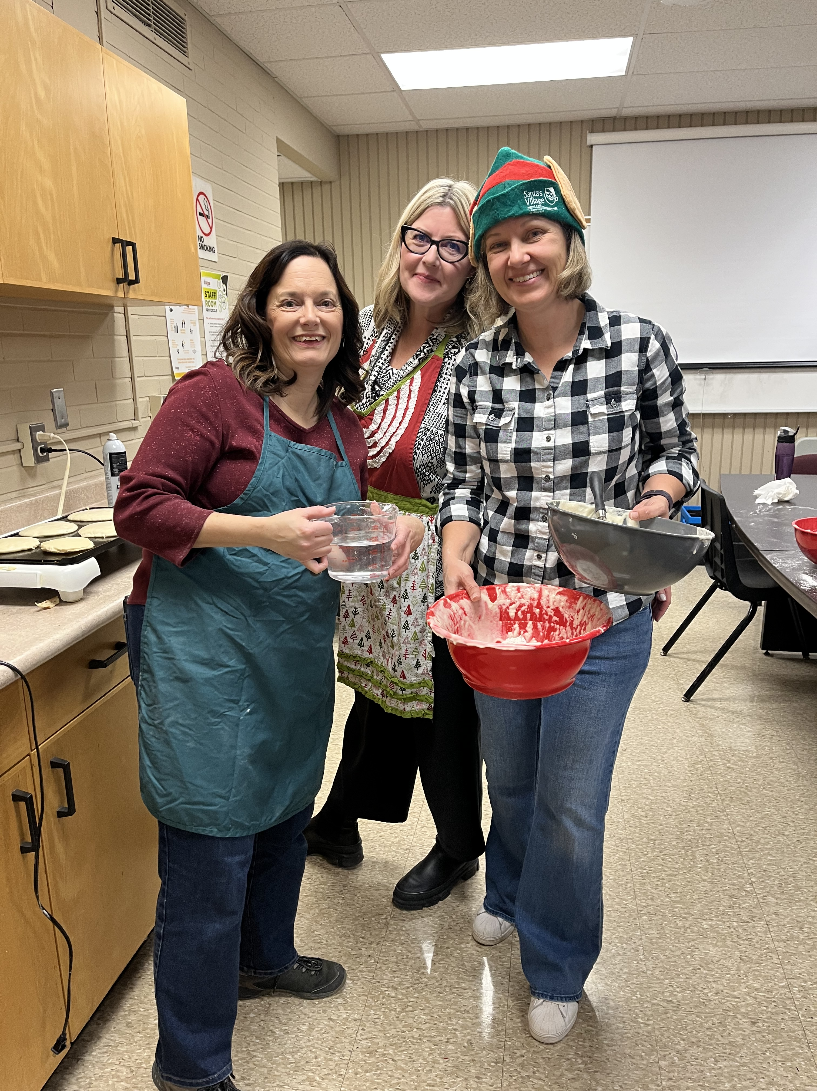
Student experiences
Holiday Pancake Breakfast
Co-hosted a holiday breakfast for students/staff – engaging parents as volunteers
Served HUNDREDS of pancakes the last day before school finished for holiday break with fantastic feedback
Staff Appreciation Lunch
Being held at the end of the week
Food donations and financial donations to support the purchase of food
**Still in need of donations**

Slide 14
Caregiver and Community Engagement

Slide 15
Engagement
9 meetings held throughout the school year
Larger attendance at meetings this year than previous
Consistent attendance meeting to meeting
Dunbarton Chair elected to the central parent council as the DDSB Secondary School representative

Slide 16
Engagement
Sub-committees created to enable parents and caregivers to contribute to areas that are of value to them
Fundraising activities that reached all parents and caregivers even if not on council, to contribute to the school community
Engaged with local business to support fundraising efforts and get Dunbarton school community members into their establishments
Active on Social Media through IG page

Slide 17
Engagement
Grade 9 day and Grade 8 parents night presentations from SCC
Enhanced level of consultation from the school administration to get feedback on various items! Thank you!
Would have liked to have been able to support more student led activities as a committee
Challenged with the communication with the student body

Slide 18
Engagement
Introduction into the Ontario Secondary School System education night for parents who have not gone through the Ontario school system
Was planned and ready to go
Translator cancelled
Ready to launch in the fall
Potential for expansion to other languages and to all parents (Ontario system or not for increased education and engagement)

Slide 19
Thank you
Thank you to all of you for attending so regularly this year! Congratulations to those with graduating students
Thank you to all of the committee chairs and the executive committee!
Thank you to the amazing administration for supporting all of our crazy ideas ;-)
See you in September!

